Slide 1
Module 1.3
PRE-CLASS CONTENT
Propositional Equivalence

Slide 2
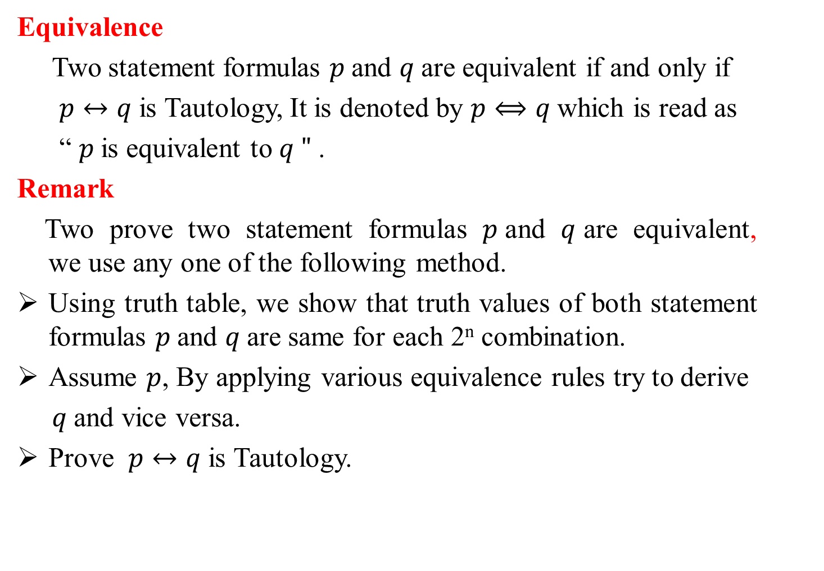
Logical Equivalences
Equivalence
Two statement formulas $p$and $q$are equivalent if and only if
$p↔q$is Tautology, It is denoted by $p⟺q$which is read as
“ $p$is equivalent to $q "$.
Remark
Two prove two statement formulas $p$and $q$are equivalent, we use any one of the following method.
Using truth table, we show that truth values of both statement formulas $p$and $q$are same for each 2^{n} combination.
Assume $p$, By applying various equivalence rules try to derive
$q$and vice versa.
Prove $p↔q$is Tautology.

Slide 3
Rules of Logical Equivalences
Equivalence Rules
Idempotent laws
Associative laws
Commutative laws
Demorgan’s laws
Distributive laws
Complement laws

Slide 4
Rules of Logical Equivalences
Equivalence Rules
Identity laws
Absorption laws
Dominance laws
Double negation law

Slide 5
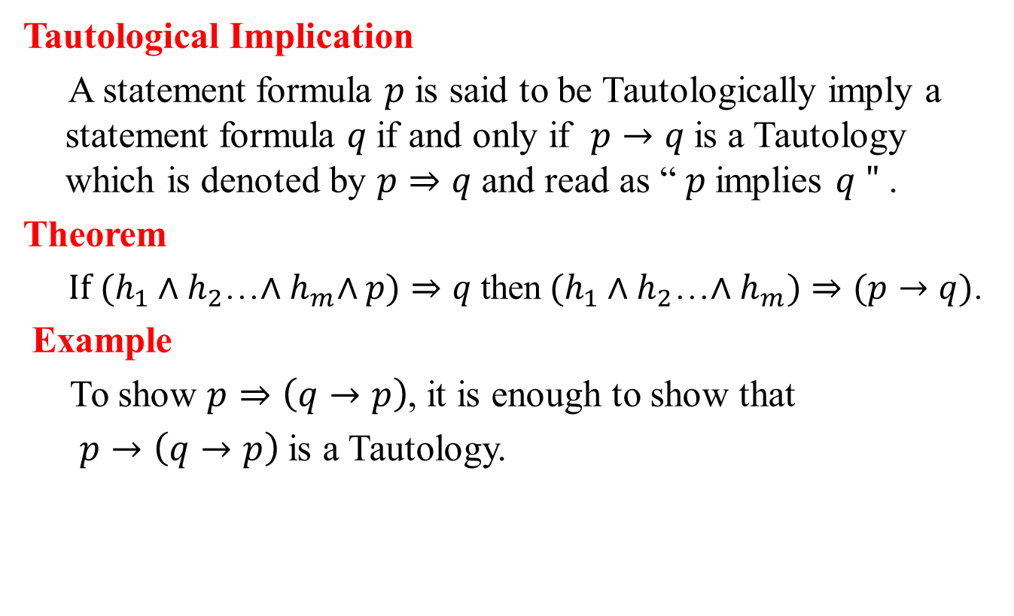
Logical Implication
Tautological Implication
A statement formula $p$ is said to be Tautologically imply a statement formula $q$if and only if $p→q$is a Tautology which is denoted by $p⇒q$and read as “ $p$implies $q "$ .
Theorem
$If (h_{1}∧h_{2}$…${∧h}_{m}∧p)⇒q$then$(h_{1}∧h_{2}$…${∧h}_{m})⇒(p→q)$.
Example
To show $p⇒\left(q→p\right)$, it is enough to show that
$p→\left(q→p\right)$is a Tautology.

Slide 6
Logical Equivalences involving Implications
Rules of Logical Implications
1.
2.
3.
4.
5.
6.
7.
8.
9.
10.

Slide 7
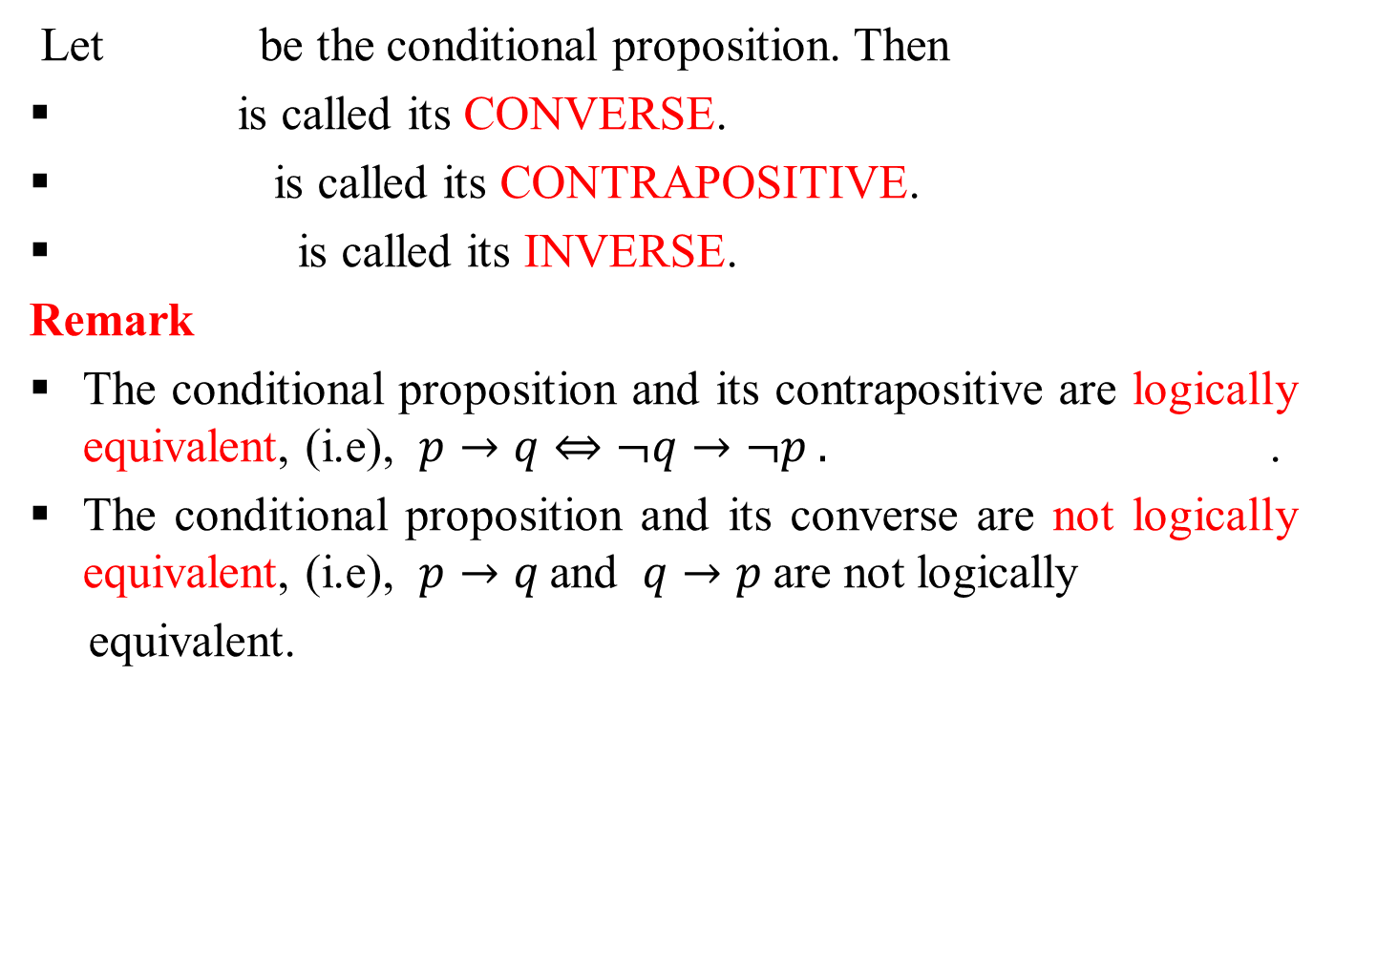
Converse, Contrapositive and Inverse
Let be the conditional proposition. Then
is called its CONVERSE.
is called its CONTRAPOSITIVE.
is called its INVERSE.
Remark
The conditional proposition and its contrapositive are logically equivalent, (i.e), $p→q⇔¬q→¬p .$ .
The conditional proposition and its converse are not logically equivalent, (i.e), $p→q$and $q→p$are not logically
equivalent.

Slide 8
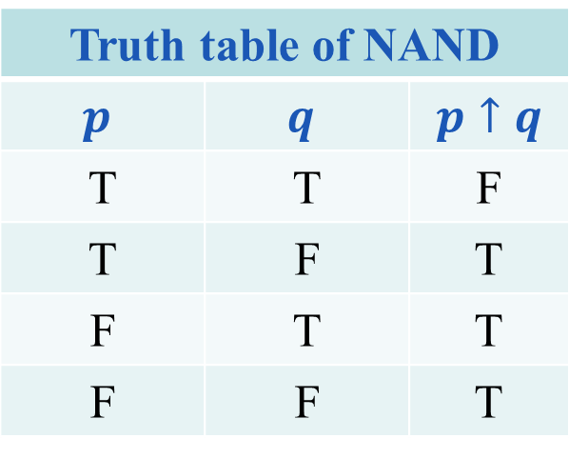
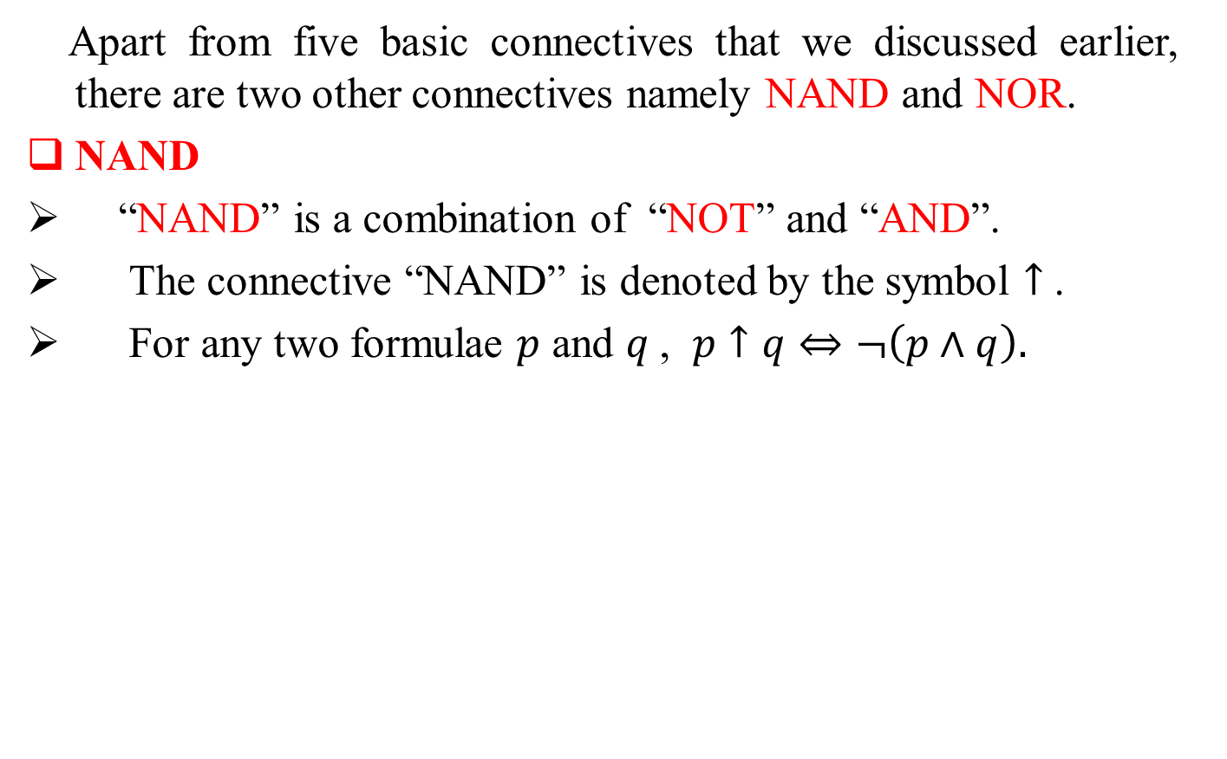
Other Connectives
Apart from five basic connectives that we discussed earlier, there are two other connectives namely NAND and NOR.
NAND
“NAND” is a combination of “NOT” and “AND”.
The connective “NAND” is denoted by the symbol $↑$ .
For any two formulae $p$ and $q$, $p↑q⇔¬\left(p∧q\right).$
Truth table of NAND
$$p$$ | $$q$$ | $p↑q$
T | T | F
T | F | T
F | T | T
F | F | T

Slide 9
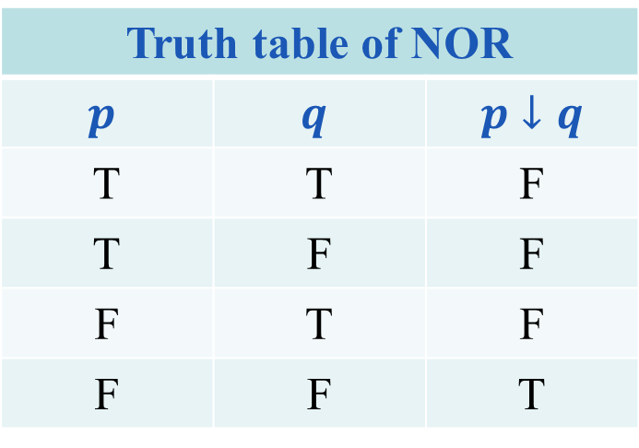

NOR
“NOR” is a combination of “NOT” and “OR”.
The connective “NOR” is denoted by the symbol $↓$ .
For any two formulae $p$and $q$ , $p↓q$is defined as
The truth table of “NOR” is tabulated below.
Truth table of NOR
$$p$$ | $$q$$ | $p↓q$
T | T | F
T | F | F
F | T | F
F | F | T

Slide 10
Duality in Propositional Logic
Duality principle
Duality principle states that for any true statement, the dual statement obtained by interchanging unions into intersections (and vice versa) and interchanging Universal set into Null set (and vice versa) is also true. If dual of any statement is the statement itself, it is said self-dual statement.
Dual of a statement formula
Two formulae A and A* are said to be DUALS of each other if either one can be obtained from other by replacing ˄ by ˅, ˅ by ˄ , T by F and F by T.
Example
Dual of is .

Slide 11
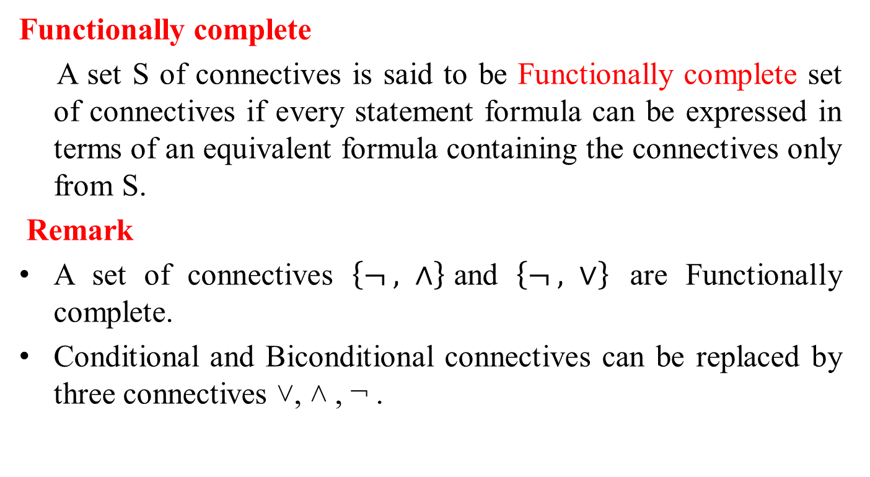
Functionally Complete Set of Connectives
Functionally complete
A set S of connectives is said to be Functionally complete set of connectives if every statement formula can be expressed in terms of an equivalent formula containing the connectives only from S.
Remark
A set of connectives $\left\{¬ , ∧\right\}$and $\left\{¬ , ∨\right\}$ are Functionally complete.
Conditional and Biconditional connectives can be replaced by three connectives ˅, ˄ , ¬ .

Slide 12
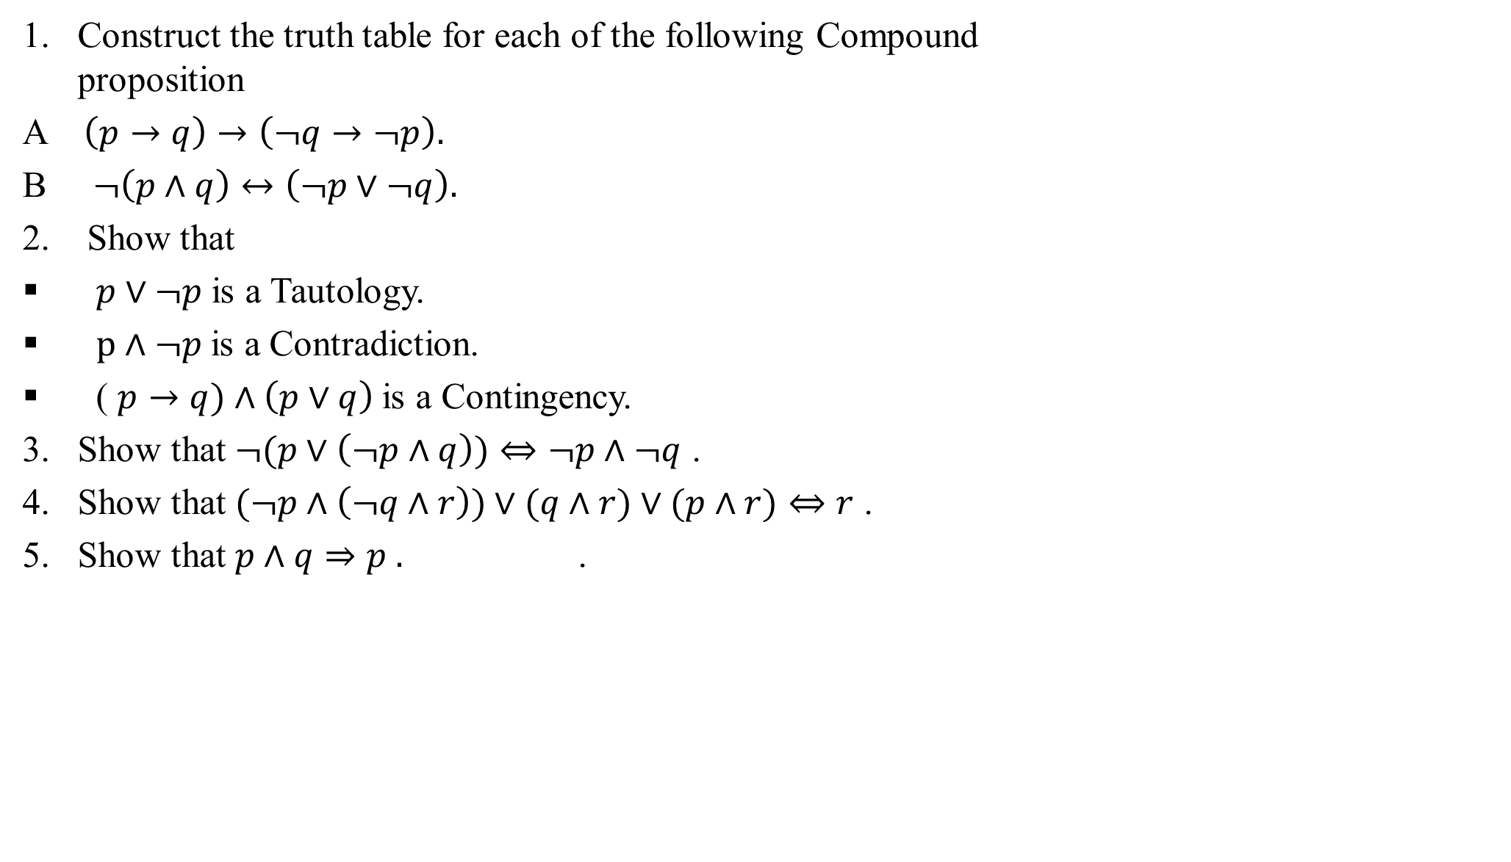
Problems
Construct the truth table for each of the following Compound proposition
A $\left(p→q\right)→\left(¬q→¬p\right).$
B $¬\left(p∧q\right)↔\left(¬p∨¬q\right).$
2. Show that
$p∨¬p$is a Tautology.
$p∧¬p$is a Contradiction.
( $p→q)∧\left(p∨q\right)$is a Contingency.
Show that $¬(p∨\left(¬p∧q\right))⇔¬p∧¬q$ .
Show that $(¬p∧\left(¬q∧r\right))∨(q∧r)∨(p∧r)⇔r$ .
Show that $p∧q⇒p .$ .

Slide 13
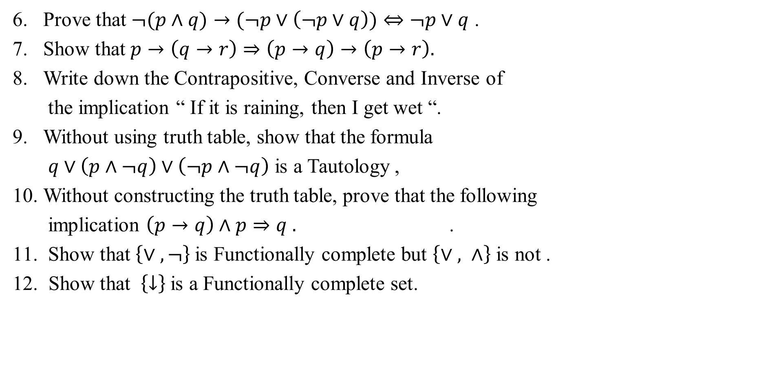
Prove that $¬(p∧q)→(¬p∨\left(¬p∨q\right))⇔¬p∨q$ .
Show that $p→\left(q→r\right)⇒\left(p→q\right)→\left(p→r\right).$
Write down the Contrapositive, Converse and Inverse of
the implication “ If it is raining, then I get wet “.
Without using truth table, show that the formula
$q∨\left(p∧¬q\right)∨\left(¬p∧¬q\right)$ is a Tautology ,
Without constructing the truth table, prove that the following
implication $\left(p→q\right)∧p⇒q .$ .
Show that $\left\{∨ , ¬\right\}$is Functionally complete but $\left\{∨ , ∧\right\}$ is not .
12. Show that $\left\{↓\right\}$is a Functionally complete set.

